Slide 1
Object Oriented JavaScript

Slide 2
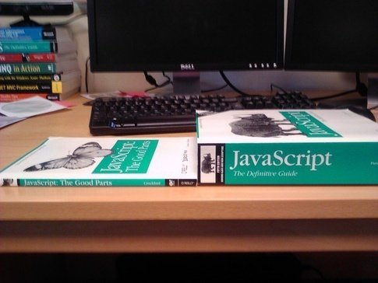
Caution

Slide 3
Index
Types
Objects
Object Literals
Calling Functions
Constructor Function
new
Inheritance
Misc

Slide 4
Types
Primitive Types
string
boolean
number
null ???
undefined ???
Object
immutable
mutable
Notes:
0

Slide 5
Objects and Object Literals
Key Value pairs
Key
Value
. Vs []
this
Dynamic objects
Notes:
1

Slide 6
Constructor function
Class ?
this
new
prototype
Notes:
2

Slide 7
Calling functions
();
.call(thisRef, param1, param2);
.apply(thisRef, paramArray);
# of parmas
arguments
Notes:
3

Slide 8
new
The 3 steps
__proto__
prototype
Notes:
5

Slide 9
new
Stark
function Stark (firstName ) {
this.firstName = firstName;
this.print = function(){
console.log(this.firstName, this.lastName);
}
}
Stark.prototype.lastName = 'Stark';
Stark.prototype.say = function(){
console.log('Winter is coming');
}
__proto__
prototype
…
Stark.prototype
constructor
lastName : Stark
say : <function>
__proto__

Slide 10
new
var arya = new Stark('Arya');
(1) Empty Object arya is created.
arya
(2) Stark.call(arya, ‘Arya’);
Constructor function is called with call or apply with arya as first argument which acts as
this in the context of constructor function.
arya
firstName : Arya
print : <function>

Slide 11
new
(3) __proto__ of arya (newly created object) is set to prototype
of constructor function
Stark.prototpye.
Stark
__proto__
prototype
…
Stark.prototype
arya
constructor
firstName : Arya
lastName : Stark
print : <function>
say : <function>
__proto__
__proto__

Slide 12
new
Stark
robb
__proto__
__proto__
prototype
firstName : Robb
…
print : <function>
Stark.prototype
constructor
Function.prototype
lastName : Stark
__proto__
arya
say : <function>
…
__proto__
__proto__
firstName : Arya
print : <function>
Object.prototype
__proto__ : null
…

Slide 13
Inheritance
The prototypical way
__proto__
prototype
Get is deep, set is shallow
Notes:
4

Slide 14
Object.prototype
Function.prototype
__proto__ : null
__proto__
…
…
Person
Person.prototype
__proto__
__proto__
prototype
say : <function>
Lannister
littleFinger
__proto__
__proto__
prototype
name : Baelish
greet : <function>
Lannister.prototype
name : undefined
greet : <function>
tyrion
trick : <function>
__proto__
__proto__
name : Imp
payDebt:<function>

Slide 15
Inheritance
Notes :
Lannister.prototype = new Person(); Lannister.prototype.trick = Sequence
Lannister.prototype.name is undefined

Slide 16
Inheritance
The other way
__proto__
Object.create()
Notes:
6

Slide 17
Misc.
for( in ) && .hasOwnProperty()
Closure
Scope
Array ????
Notes:
5 Uncomment
7
9
8

Slide 18

Questions ?
http://thetechtrash.blogspot.in/2014/12/object-oriented-javascript.html

